Slide 1
Randomized and Approximation Algorithms for Vertex Cover
CPSC 535 Group #5
Rohit Bhaskar Uday
Viditi Vartak
Tushar Yadav
Rohit Chowdary Yadla
Huan Ying
Shiyun Zhou

Slide 2
Introduction
Vertex problem
Focus on developing approximate and randomized algorithms to address the NP-completeness problem..
Achieve efficient solutions that balance computational complexity and solution quality.
NP Problem
Randomized Algorithms
Approximation Algorithms

Slide 3
Vertex Cover
Timeline of the Vertex Cover Problem
18th Century: Leonhard Euler’s Seven Bridges of Königsberg
20th Century: Formal Definition
1971-1973: NP-Completeness Established
1970s: Focus on Approximation Algorithms
1980s-1990s: Development of Randomized Algorithms
21st Century: Modern Developments

Slide 4
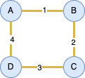
Vertex Cover
A vertex cover of a graph is a set of vertices such that every edge of the graph is incident to at least one vertex in the set. The problem of finding a vertex cover is to determine the smallest possible set of vertices that covers all edges.
Consider a square graph with vertices A, B, C and D, and edges 1, 2, 3 and 4. The sets {A,C} or {B, D} are all minimal vertex covers.
Given graph G = (V, E)
Where, G = Graph
V = Set of Vertices = {A, B, C, D}
E = Set of Edges = {1, 2, 3, ,4}
V’ = Minimized Vector which covers all edges of graph G = {A, C}

Slide 5
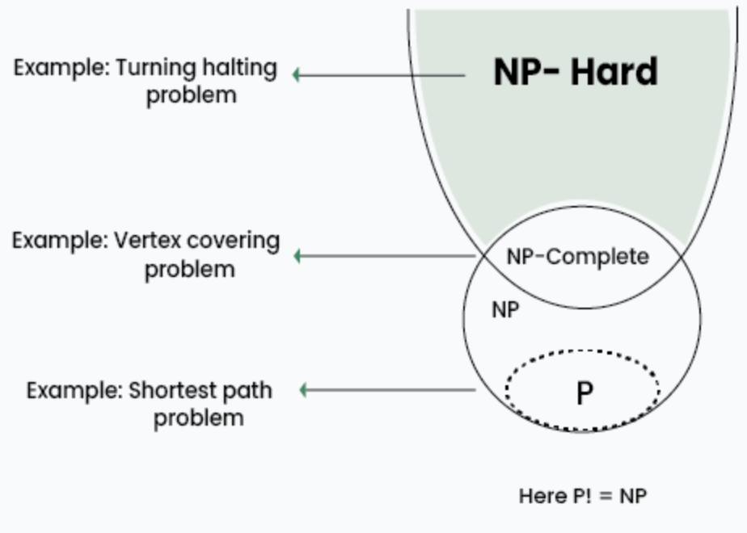
P, NP, NP Hard, NP Complete
P : The class P consists of those problems that are solvable in polynomial time O(n^{k})
NP : Non-Deterministic polynomial time. NP means verifiable in polynomial time
NP Hard = every problem in NP can be poly time reduced to it.
NP complete :
Need to be in NP
Need to be in NP-Hard
Notes:
for some constant k, where n is the size of the input to the problem
•NP is not the same as non-polynomial complexity/running time. NP does not stand for not polynomial.
P is a subset of NP

Slide 6
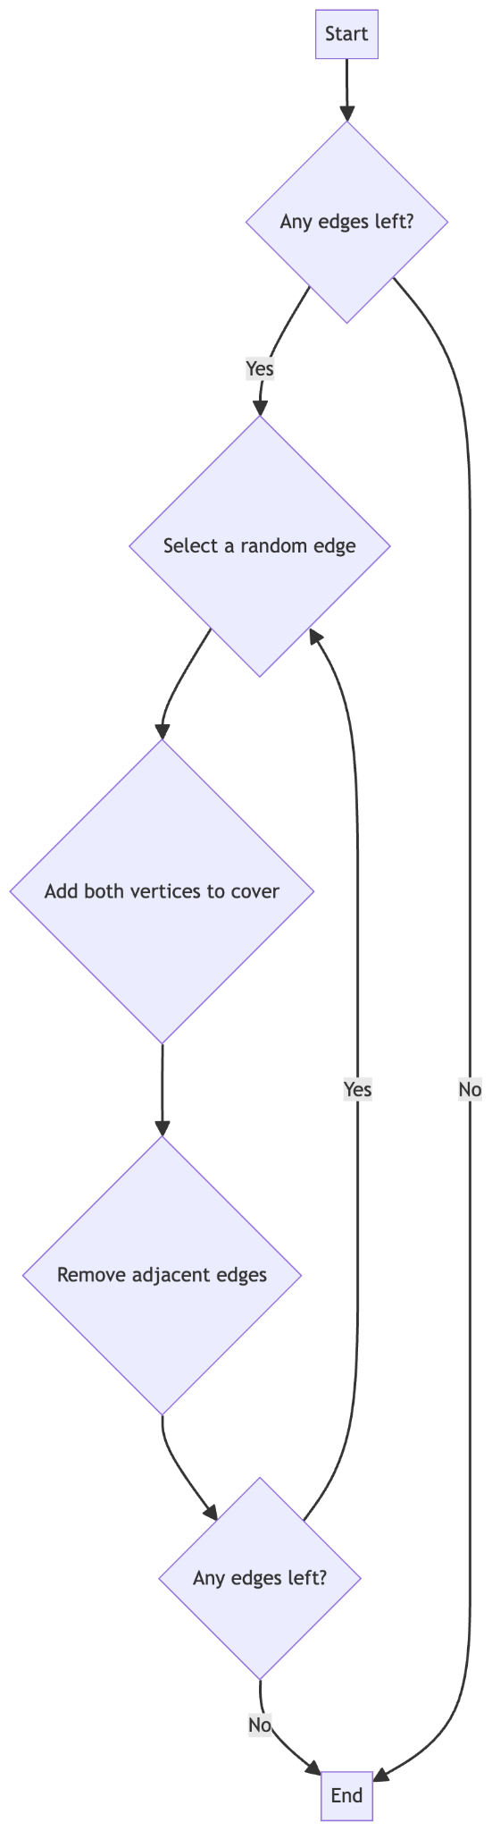
Randomized Algorithm for vertex cover
Randomized algorithms for the Vertex Cover problem use a probabilistic method to select vertices. This approach often simplifies the process and can yield efficient average runtime, although it may not guarantee the best possible solution.
Algorithm Flow…
Start: Begin the algorithm.
Any edges left?: Check if there are any edges remaining in the graph.
Select a random edge: If there are edges left, randomly select one.
Add both vertices to cover: Add the two vertices connected by
the selected edge to the vertex cover.
Remove adjacent edges: Remove all edges adjacent to the selected vertices.
Any edges left?: Repeat the process if there are still edges remaining.
End: Finish the algorithm when no edges are left.

Slide 7
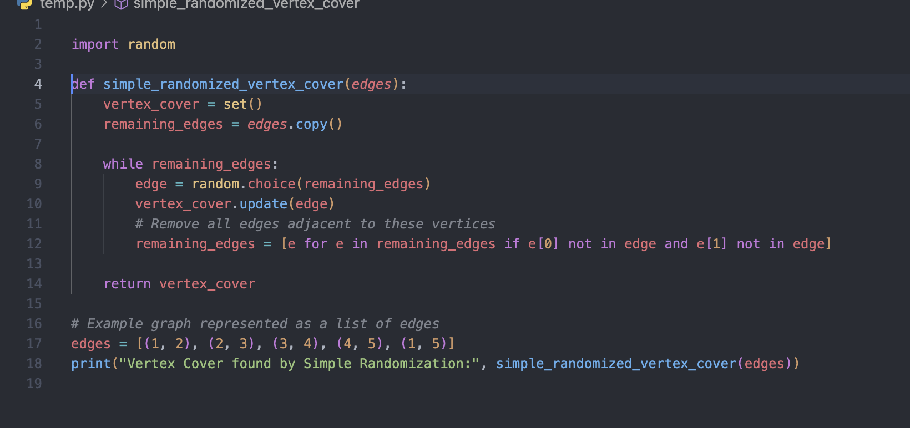
Randomized Techniques
Simple Randomization Algorithm
Simple Randomization algorithms use straightforward random selection without additional modifications like weighting.

Slide 8
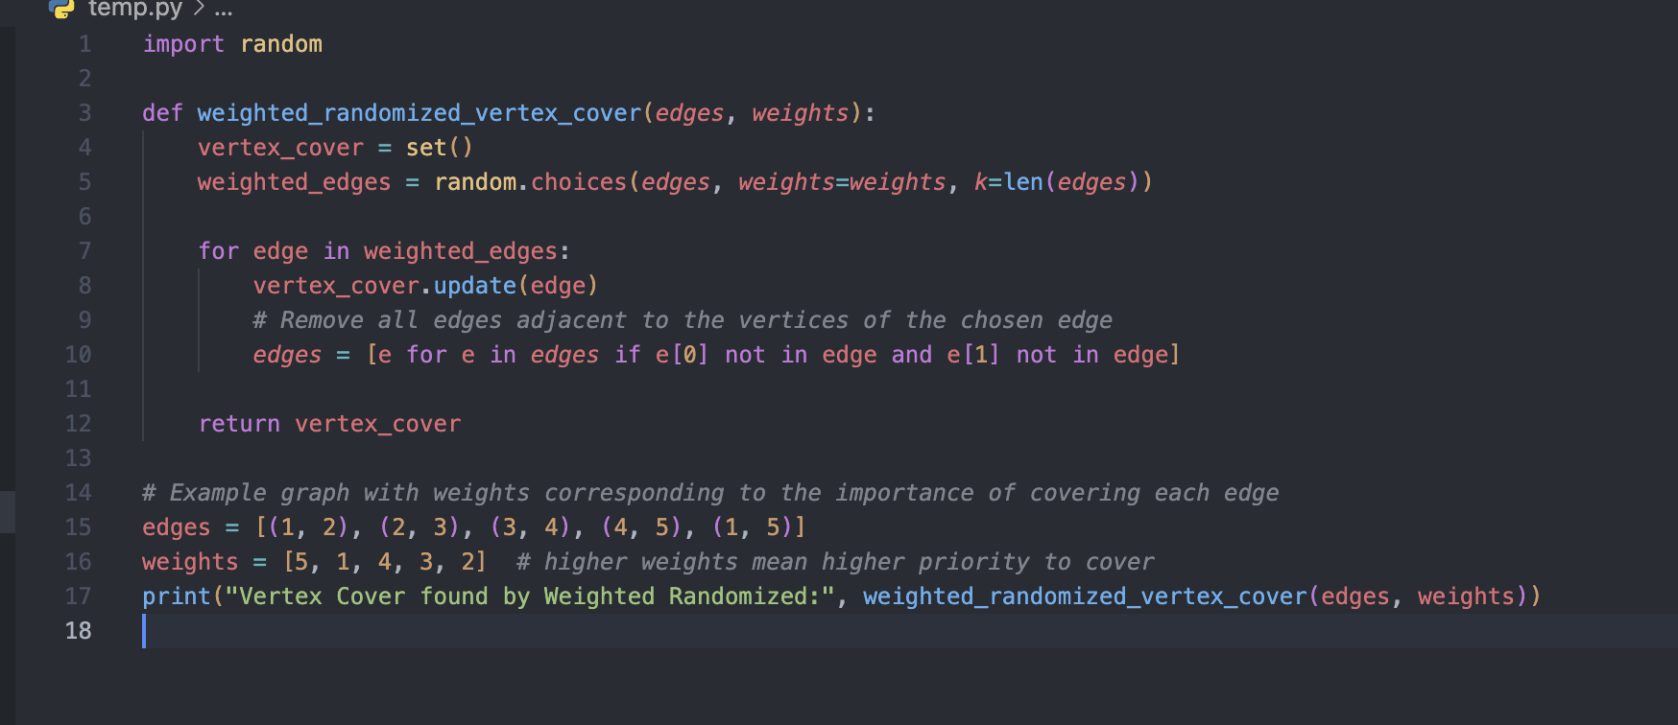
Randomized Techniques
Weighted Randomized Selection for Vertex Cover
Weighted Randomized Algorithms are useful when elements (like edges or vertices in graph problems) have different weights or probabilities associated with them. These weights influence the likelihood of each element being chosen during the algorithm's execution.

Slide 9
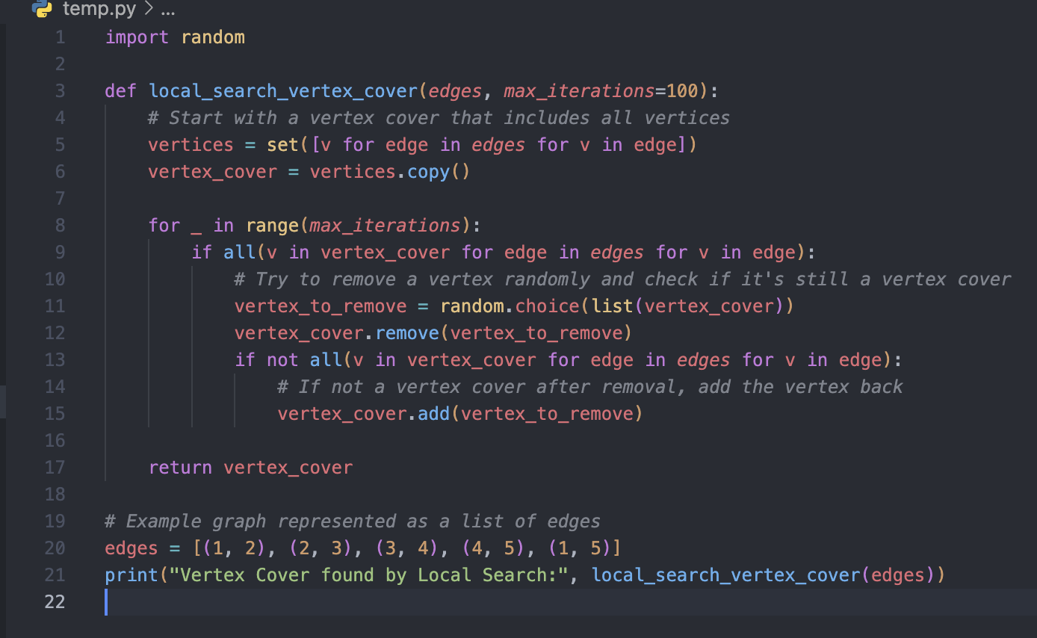
Randomized Techniques
Vertex Cover using a Local Search Randomized Algorithm
Local Search algorithms operate by iteratively moving from a solution to a neighboring solution that is better according to some criteria. For many optimization problems, a "neighborhood" structure is defined, and the algorithm explores this structure to find an improved solution.

Slide 10
Approximation Techniques for vertex cover
What are Approximation Algorithms?
Algorithms for solving optimization problems, especially NP-hard problems where finding an optimal solution efficiently is not feasible.
Purpose
To find solutions that are close to the best possible outcome within a reasonable amount of time.
Strengths of Approximation Algorithms
Provable Guarantees
Provide provable guarantees on the closeness of the computed solution to the optimal value.
Significance in Decision Making
Critical in scenarios where decisions rely on the algorithm's output; ensures that even non-optimal solutions do not lead to significant inefficiencies.
Applications
Widely used in operations research, computer science, and economics.
Particularly valuable in real-world scenarios where speed is prioritized over finding the perfect solution.

Slide 11
Approximation Techniques for vertex cover
Algorithm Description
Process
Continuously pick an arbitrary edge.
Add both vertices of this edge to the vertex cover.
Remove all edges incident to these vertices.
Repeat until no edges remain in the graph.
Complexity and Effectiveness
Time Complexity
O(E)
O(E) where
E
E is the number of edges, since each edge is processed exactly once.
Approximation Ratio
Guarantees a 2-approximation ratio, where the size of the vertex cover found is at most twice the size of the minimum vertex cover.

Slide 12
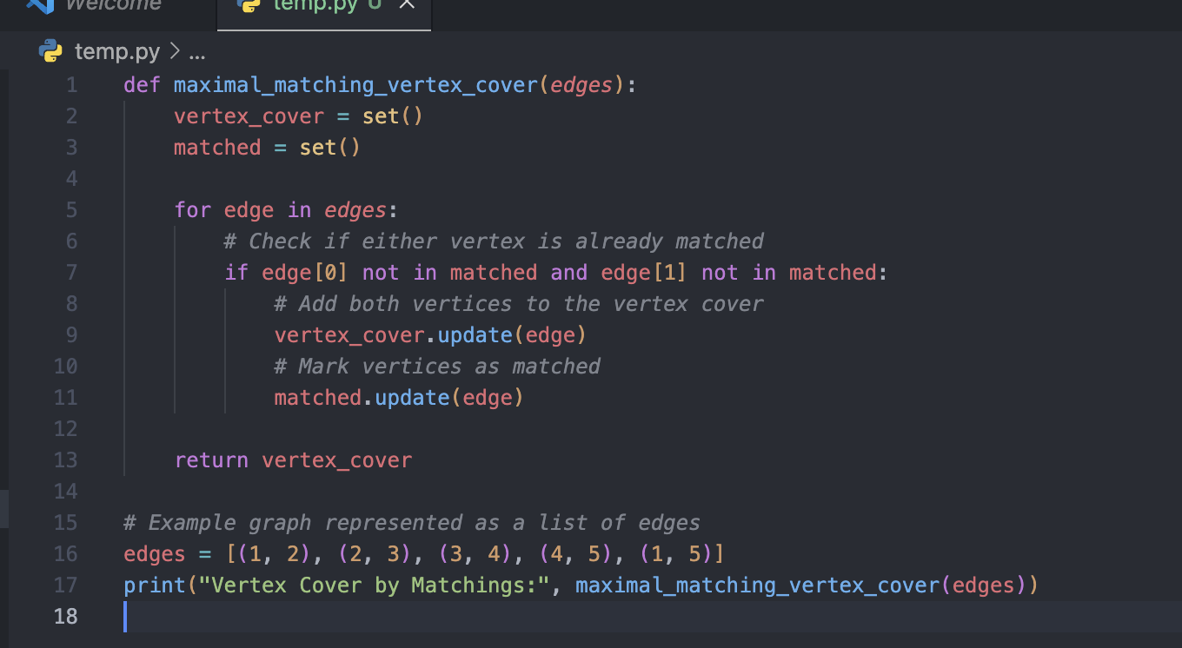
Approximation Techniques
Minimum Vertex Cover by Matchings Approximation Algorithm
The Minimum Vertex Cover by Matchings algorithm is based on the concept that any maximal matching in a graph provides a 2-approximation of the minimum vertex cover. Algorithm Steps:
Find a maximal matching in the graph.
Include both endpoints of each edge in the matching in the vertex cover.

Slide 13
Approximation Techniques
Vertex Greedy Approximation Algorithm
The Vertex Greedy Approximation Algorithm for Vertex Cover iteratively selects the vertex with the highest degree (i.e., the vertex connected to the most remaining edges). This vertex is added to the cover, and all its incident edges are removed from the graph. The process repeats until there are no edges left.
Algorithm Steps:
While there are edges remaining,
pick the vertex with the highest degree.
Add this vertex to the vertex cover.
Remove all edges incident to this vertex.

Slide 14
Comparison: Approximation vs Randomized
Aspects | Randomized algorithms | Approximation algorithms
Guarantee | Do not guarantee to find the optimal vertex cover | Guarantee to find a vertex cover that is at most some factor larger than the optimal vertex cover
Efficiency | Typically very efficient | May be slower than randomized algorithms
Use of randomness | Use randomness to generate and improve vertex covers | Do not use randomness
Use cases | Network routing, Resource scheduling, Load balancing (Google Maps, Netflix CDN) | Circuit Design, Network Design, Task Scheduling
Application-Specific Considerations | Dependent on specific requirements, constraints, and intricacies of the domain, such as data complexity, computational resources, real-time processing needs, and the level of tolerance for approximation. | Depends on factors such as real-time performance requirements, resource constraints, or the nature of the problem being solved

Slide 15
Applications
Network Optimization by reducing the number of hubs by 20% significantly cutting the costs while maintaining the network integrity and performance.
Bioinformatics Research, randomized vertex cover algorithm swiftly identifies potential drug targets in protein interaction networks, notably in cancer pathways, offering accelerated insights for disease treatment. Its efficiency and scalability highlight its pivotal role in advancing biomedical research.

Slide 16
Recent Advancement
Improved Approximation Ratios: Researchers continually strive to improve the approximation ratios of algorithms for the Vertex Cover problem. Recent advancements may focus on achieving tighter bounds on the approximation ratio, either through algorithmic improvements or by refining the analysis of existing algorithms.
Kernelization Techniques: Kernelization aims to reduce the size of the input graph while preserving the solution to the Vertex Cover problem. Recent research may have introduced novel kernelization techniques that efficiently identify and eliminate redundant vertices and edges, leading to smaller problem instances that can be solved more quickly.
Parameterized Algorithms: Parameterized algorithms target specific structural parameters of the input graph to achieve efficient solutions. Recent advancements may involve the development of new parameterized algorithms for the Vertex Cover problem with improved runtime performance and approximation guarantees.
Hybrid Approaches: Hybrid algorithms combine elements of different algorithmic techniques, such as randomized algorithms, approximation algorithms, and heuristic methods, to achieve better overall performance. Recent advancements may focus on the design and analysis of hybrid algorithms tailored specifically for the Vertex Cover problem.
Parallel and Distributed Computing: With the increasing availability of parallel and distributed computing resources, recent advancements may involve the design of parallel and distributed algorithms for the Vertex Cover problem. These algorithms aim to leverage the computational power of multiple processing units to solve large-scale instances of the problem more efficiently.
Fine-Grained Complexity Analysis: Fine-grained complexity analysis seeks to understand the inherent difficulty of computational problems in terms of specific parameters of the input. Recent advancements may have provided new insights into the fine-grained complexity of the Vertex Cover problem, leading to a better understanding of the limitations of existing algorithms and opportunities for further research.

Slide 17
To Summarize
Vertex Cover
P NP NP Hard, NP Complete
Randomized Techniques and Algorithms
Approximation Techniques and Algorithms

